Slide 1
Glymass
Write by 曾煥權、曾偉綱

Slide 2
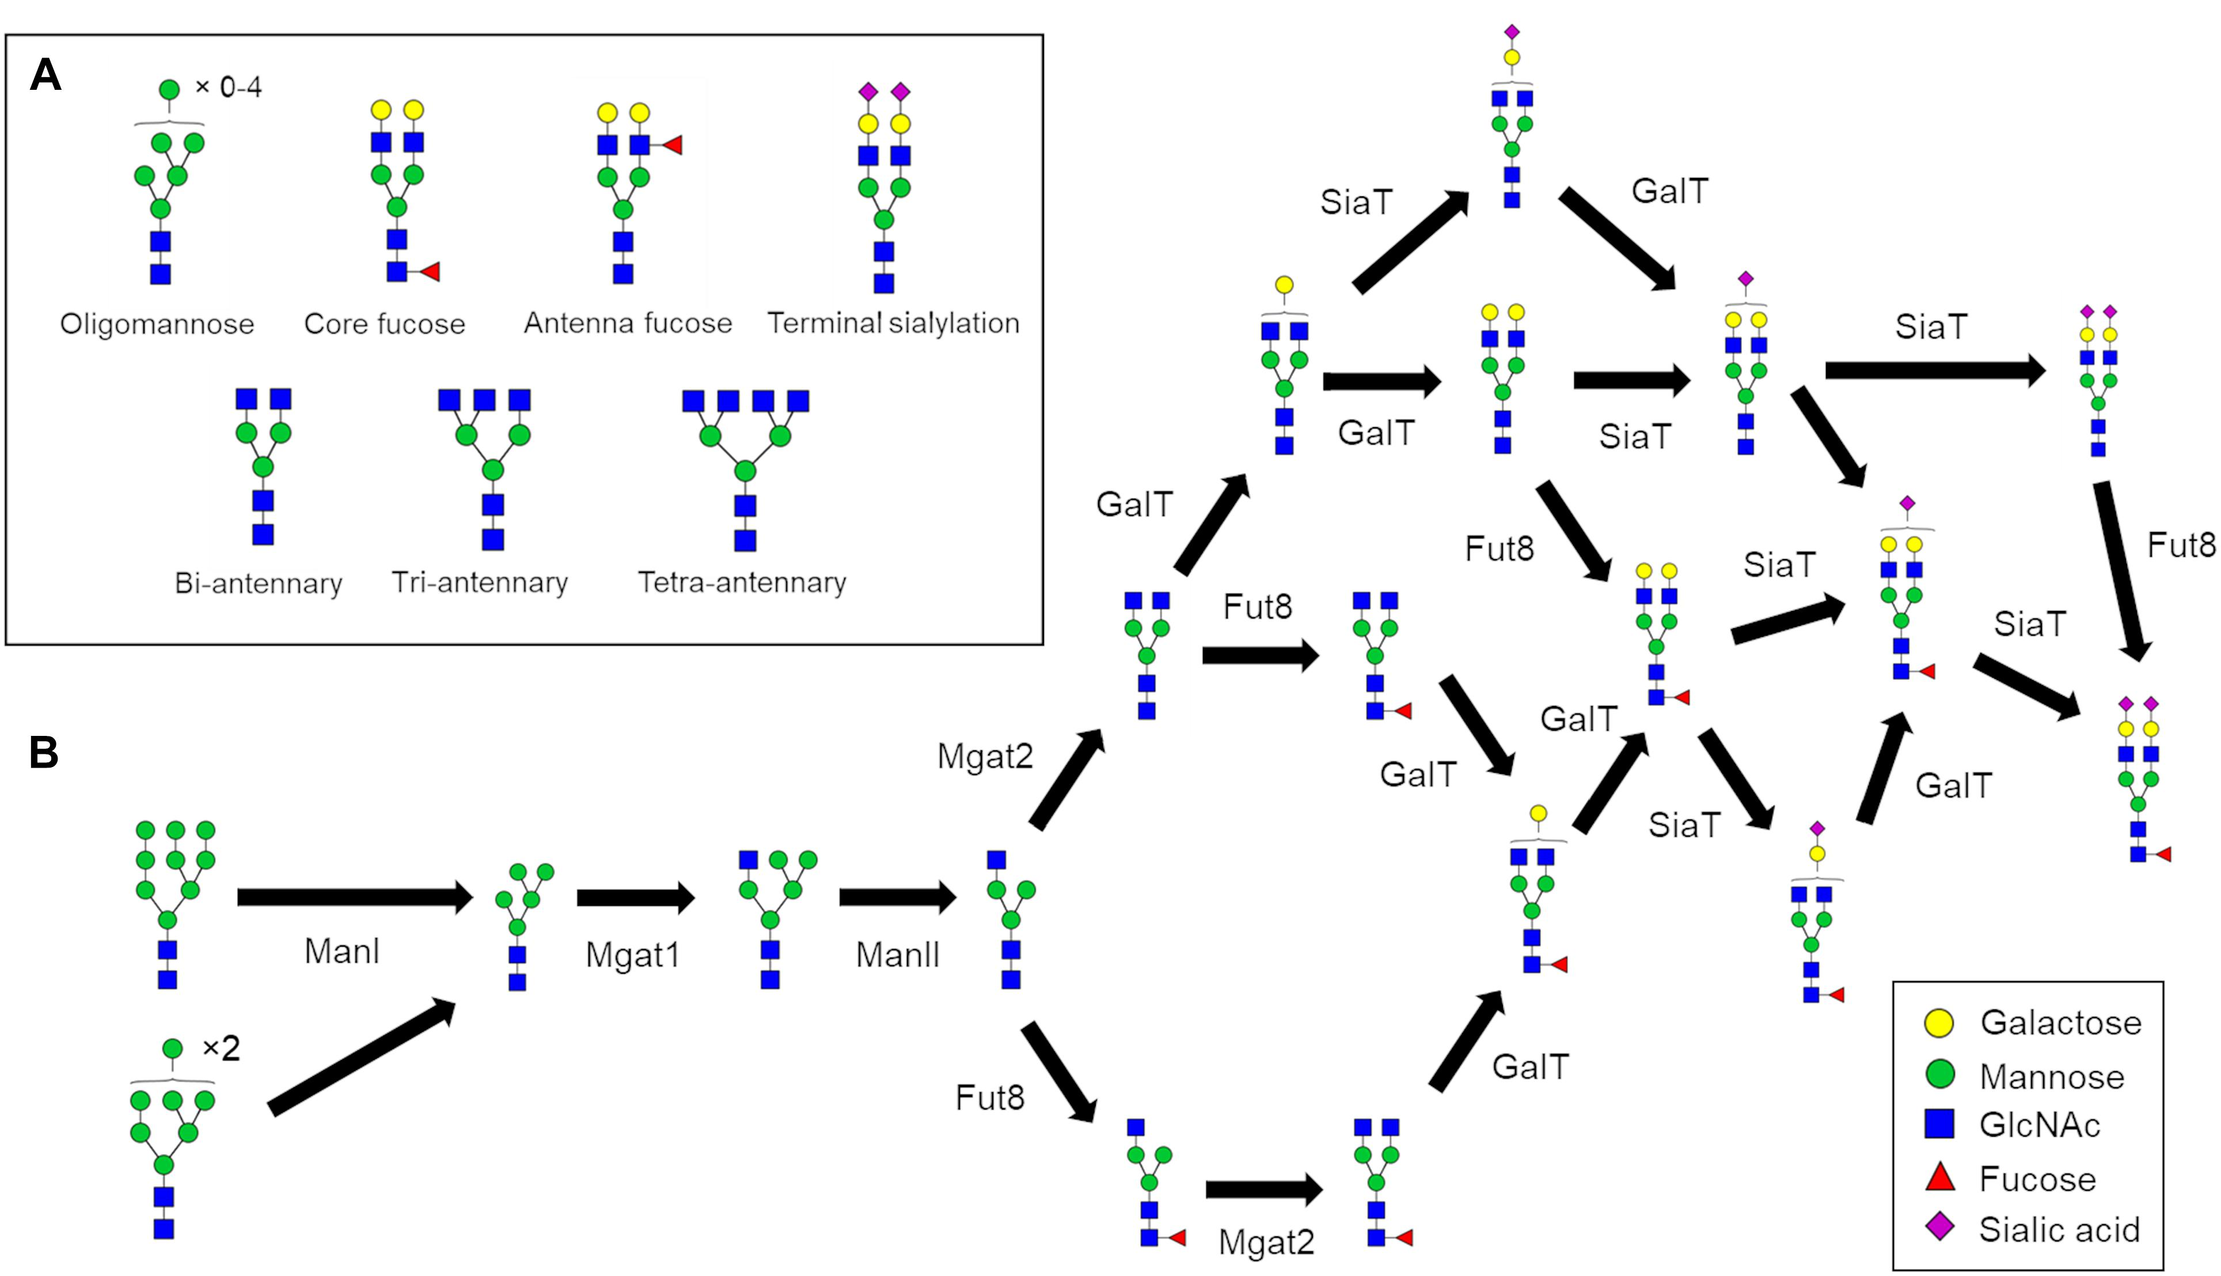
What is glycan?

Slide 3







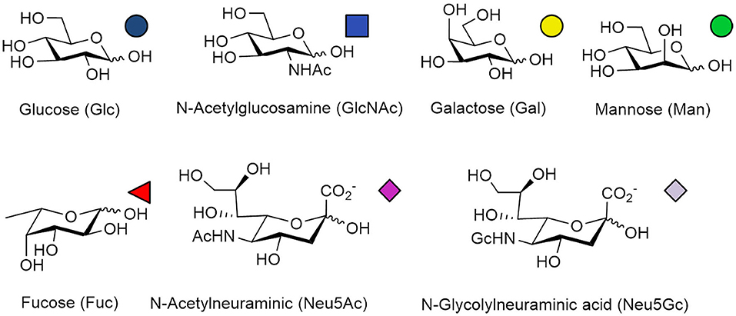
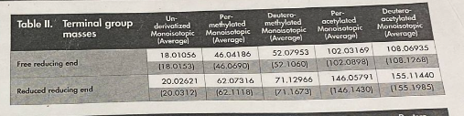
About fit composition
Monosaccharide units building up the intact glycan have their own mass*
Mass may be the same (all the circles here are C₆H₁₂O₆) while amino acids don’t
Labeling, derivatization (here, permethylation replaces terminal OH with OCH₃)
Based on our biological knowledge, if we see a sugar signal with mass = M
Suppose it is a N-glycan (has tri-mannosyl core)
In mammals, and this sample doesn’t produce strange sugars
M = a x + b x (b >=3) + c x + d x + e x + z while 𝑎, 𝑏, 𝑐, 𝑑, 𝑒∈ ℕ ( >= 0, integer) 𝑧=𝑐𝑜𝑛𝑠𝑡
z is some modifications on non-reducing end (determined by chemical experiment)

Slide 4



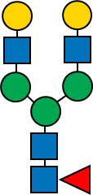
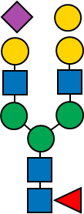
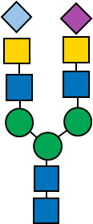

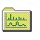

About analyzing glycans in MS, MS/MS spectrum data
Researcher wants to know glycans in mouse
Find information from papers
Get gene or protein expression by experiments
Acquire data from instruments
An expected glycan list
Adjust instrument settings to get better signal
Calculate data in silico/
From previous research
Check if the expected glycan exists
Raw file
View the spectrum in vendor software
Quantitation
Spectra file
Differs among manufacturers
Link to certain issue in biology
Filename.raw
Validate structures
Generate glycan list
2 strategies in analyze glycans:
Search known glycans based on database (fast)
Find unknown glycans based on hypothesis/knowledge/observation (slow, difficult)

Slide 5
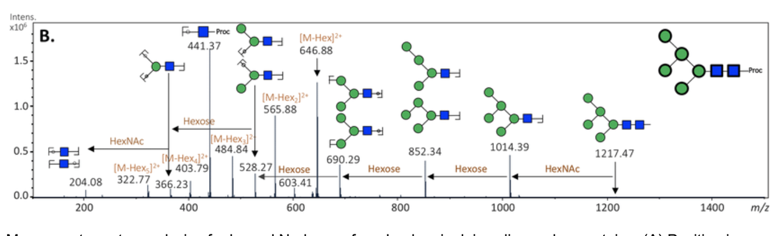

Slide 6
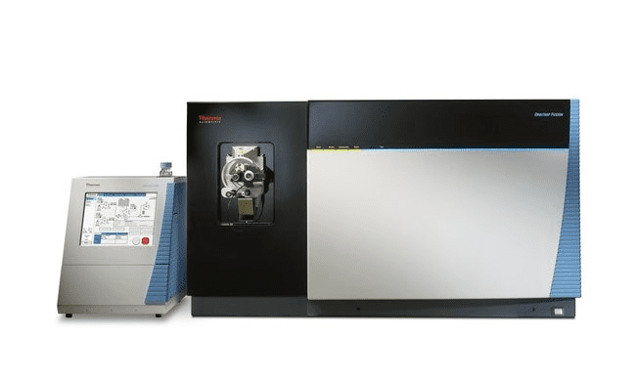
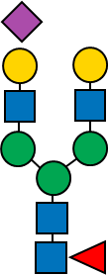

About analyzing glycans in MS, MS/MS spectrum data
Set the parameter properly to detect glycans
We can analyze the data post-experiment, but if the data isn’t detected under the wrong settings and collected the data, then we can never find it out in the data processing part.
Use Mass spectrometer to get MS1 (survey scan: to get precursor mass) and MS/MS (fragment ion scan: to get the fragment information from the precursor)
A set of diagnostic ions are produced from certain glycans, (varies from different type of glycans, chemical treatment on glycan sample before MS analysis, the MS buffer system…, etc.)
We can identify a glycan composition by it’s MS2 pattern and MS1 precursor mass
The information provided in spectrum is incomplete, so we interpret the glycan structure either by PREVIOUS research (site/sugar-unit specific enzyme digestion, NMR, lectin binding array) or the glycogene expression of the sample source organism)
MS1 Survey scan
MS2 fragmentation
[M+2H]²⁺
B₁
[M+3H]³⁺
C₁
C₂
C₃
C₄
C₅
C₆
C₇
C₈
C₉
Y₆
Y₅
B₂
Diagnostic ions
Y₄
…
[M+4H]⁴⁺
Y₂
S
N
Y₁
Z₉
Z₈
Z₇
Z₆
Z₅
Z₄
Z₃
Z₂
Z₁
Y₀
N
Glycan: glycan m/z
Glycans: b/y ions
Glycopeptide: c/z ions
Glycopeptide: peptide + glycan m/z

Slide 8
Collaborator
Progress
Dr.Khoo in Academia Sinica
Current need of an automation workflow on multiomics approach

Slide 9
The difficulties of analyzing glycans in MS spectral data
Detection limit of the instruments
Not all of glycan signals are major peaks
One spectrum is usually insufficient for interpreting a glycan composition
Sometimes one spectrum contains signals from multiple glycan structures (not separated by liquid chromatography, contaminants, etc. )
Redundant mass caused by nature of sugar units
Same molecular formula may represent different type of sugar unit
Like C6H12O6 can be both glucose, galactose, mannose
Need to interpret it with glycobiology knowledge
Enzyme cleavage may be an option when needed
Glycogene -> glycan structure is not 1 to 1
One certain structure may be made by multiple enzymes, respectively
One enzyme may be also capable to make multiple kinds of structures

Slide 10
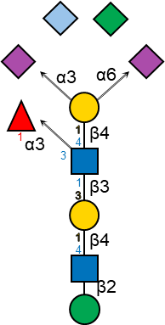
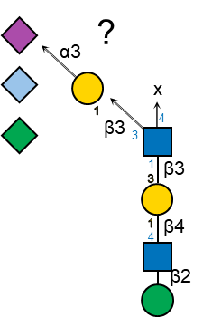
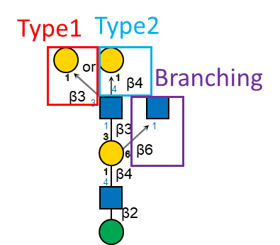
Overview of the pipeline
Extract peaklist and precursor info
Fit composition
INPUT
csv
csv
Raw file
Extracted spectra data (csv)
For i in spectra: find composition( )
We haven’t optimized the searching & comparing algorithm
This is the part we have to improve in this year (I may ask sensei and other lab members)
From previous preliminary test, we know that decision tree on BOTH ms1 and ms2 fragments give ~90% accuracy to limited class labelled in sample (Better than a beginner to this field)
Those possibly a glycan mass
For j in fit_spectra: compare if glycan fragments [list] exist get matching score
Those higher than the threshold
csv
For k in hit_spectra: check structure-specific ions existence
check glycogene expression
csv
Annotated/Predicted glycan list in the intact spectra data

Slide 11
Read/Extract data part
GlycoMSParser
Based on Thermo Scientific’s “MSFileReader” and a python package “pymsfilereader” to read proprietary format (RAW file) of my previous data
Python 3.6+
Some of other software does similar task to read a RAW file
All of them require same gadget to read/write the data; windows only
A way to bypass it is to convert the raw file to general format ON a Windows PC
ProteoWizard provides a MSConvert (C language, command-line based) tool for converting RAW to mzML (xml-based general format)
GlyRecSoft can read RAW file and process it (only search result csv is shown)

Slide 12
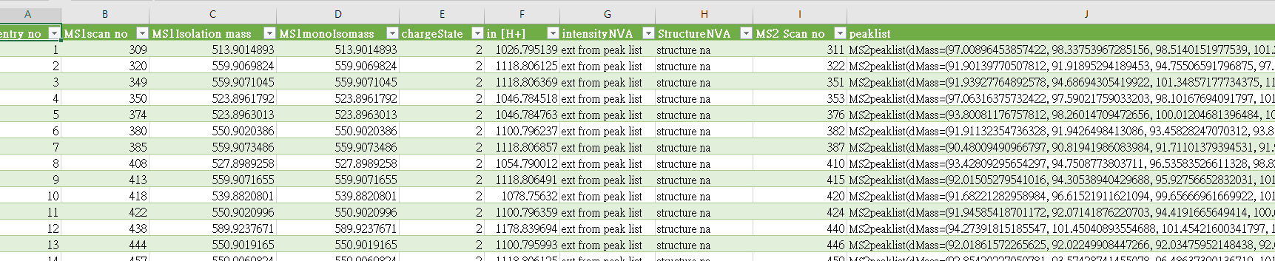
Points of our extractor
Extract only needed information and export to a csv file
Easier for further handling of data preprocessing
Reduce processing time and intermediate file size (raw file ~ 1GB, while uncompressed spectra file in plain text ~ 10GB, our csv only takes ~100MB)
Contains: entry no. ; MS1 scan no.; MS1 isolation mass; MS1 mono mass; chargestate in H+ (calculated by highlighted items); intensity (not using currently); structures (not using currently); MS2 no. ; peaklist (dMass=(m1,m2…mn), dIntensity=(d1,d2…dn))
(In dev) GUI support
(In dev) Allows project management
(In dev) support other formats from MS instrument
(In dev) make the raw file extractor cross-platform executable

Slide 13
About fit composition
Monosaccharide units building up the intact glycan have their own mass*
Mass may be the same (all the circles here are C₆H₁₂O₆) while amino acids don’t
Labeling, derivatization (here, permethylation replaces terminal OH with OCH₃)
Based on our biological knowledge, if we see a sugar signal with mass = M
Suppose it is a N-glycan (has tri-mannosyl core)
In mammals, and this sample doesn’t produce strange sugars
M = a x + b x (b >=3) + c x + d x + e x + z while 𝑎, 𝑏, 𝑐, 𝑑, 𝑒∈ ℕ ( >= 0, integer) 𝑧=𝑐𝑜𝑛𝑠𝑡
z is some modifications on non-reducing end (determined by chemical experiment)

Slide 14
About fit composition - cont
Some biological restraints limit the possible glycan composition in real world
While making in silico glycan lists will give ~half of “invalid structures”
Sadly, based on my knowledge and instrument detection limit, we can get ▲= 0~5; ● ● ＝0~9 (max 14) ■ ■ ＝0~10 (max12) ◆=0~4 ◆= 0~4 and (◆ + ◆ )= 4 for N-glycans.
If we apply a brute-force list generation, the list only takes 6 x 10 x 11 x 5 x 15*^{(my calculation on ◆)} , = ~50k composition with current naming style may take 24 bytes = 1.17Mb for searching
Currently this doesn’t make a bottleneck, so we’ve decided to neglect this issue

Slide 15
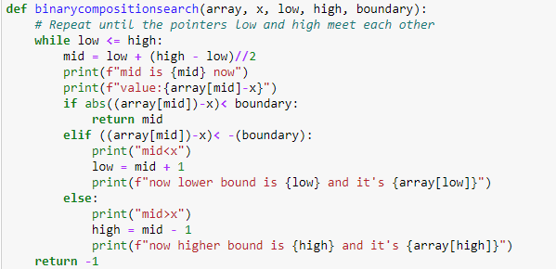
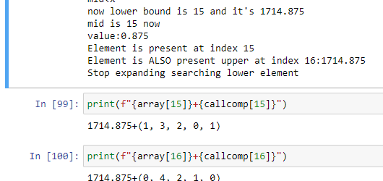
Points of fit composition
Iterates through the csv to filter if a spectrum can be assigned into a glycan mass (from it’s MS1 precursor mass)
Doing binary search to reduce searching time from O(n) to O(log(n)) probably
Since we have to search many (~10k) spectra, the time spent and memory used may become observable
List the different composition when one mass can have multiple possibilities
Take 1714 for example, this mass have 2 possible composition: 1F3H2N0S1G or 0F4H2N1S0G

Slide 16
Aims of this project
Develop an algorithm for automatically identifying polysaccharide (glycan) patterns within a database of mass spectrometry spectra, aimed at minimizing labor and time required for the identification process.
3 steps in project
Extract and filter the data
Manual parameterization or machine learning training to determine suitable model parameters.
Import gene expression data from database to improve accuracy
Notes:
. (only a few research about this)

Slide 17
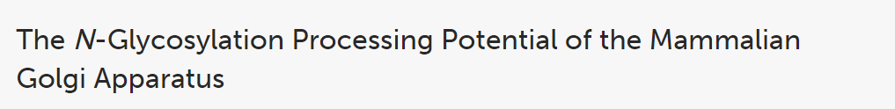
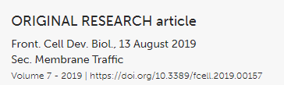
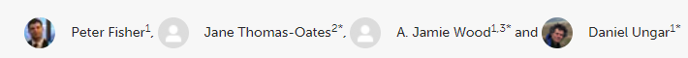
So where is the ML/DL part?
Progress
How glycosyltransferase affects the glycan structure
Which is difficult to optimize in the next 2 years
(I think I’ll start to write paper before this part getting optimized)

Slide 18
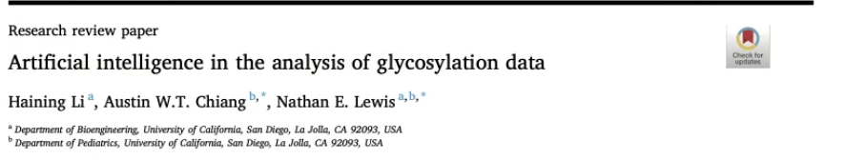

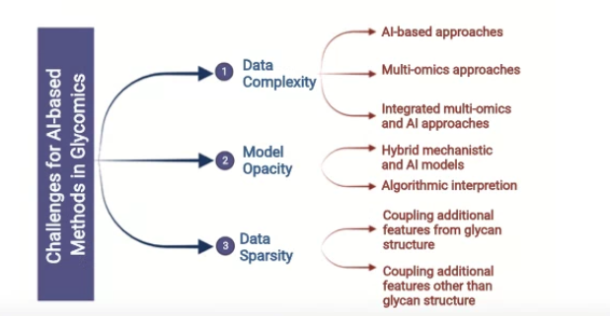

Slide 19
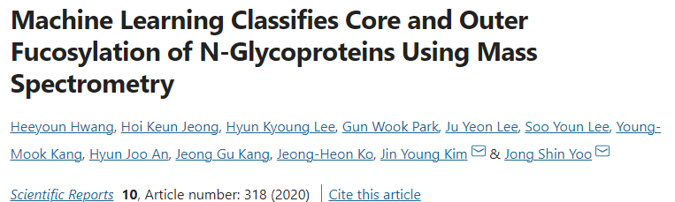
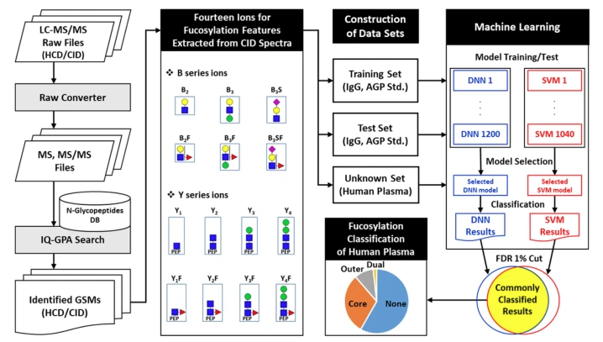

Slide 20

GlycoMSParser
INPUT
Extract certain info from RAW file
Support other formats in future
csv
Unlabelled
Need further processing
Spectra file
ThermoFisher RAW
Filename.raw
Rawoutput.csv
trytolistoutheaders.py
As input file
Rename when complete
RAWheaderextractor.py
Peak searching module
Main file
Find spectra with desired ion fragment (user defined)
Process
MSext_main.py
FilterMS2.py
comparepeaklist.py
csv
Filtered
Need further labelling
Developing
Search and output searched entries
For further labelling
Process
Extracted.csv
As input file
GUI
Use Tkinter*
Annotationhelper.py
filterresultreader.py
annotationhelper.py
MSext_main_GUI.py
csv
Labelled
👀
Results
For machine learning
Placeholder
csv
As input file
visualize
Labelled.csv
Result.csv
mltest_methodname.py
As input file

Slide 21
Simplify the task and focus on “features”
Progress
Start analyze spectrum and try to annotate glycan compositions from “glycotopes” instead of all information as user can provide as possible
csv
Peak searching module
Process raw output
Call
Rawoutput.csv
Find spectra with desired glycotopes and fragment sets (user defined)
comparepeaklist.py
Filtered
Need labelling
FilterMS2.py
csv
Fragment set can be learnt and optimize for different experiment approaches
Try to fill out composition and features automatically
Manually label for wrong/missing label, information, etc
Extracted.csv
Label data
Annotationhelper.py
csv
Labelled
Labelled.csv

Slide 22
The question I asked in last long progress
Progress
Input
Output
ID? Input?
(time-based)
has
Deduce
MS2 scan
Peaklist
Structure
Old
(hit peaklist, relative intensity)
Based on observed peaks
traceback
MS1 scan
Theo. Mass
By calculation
May be input?
Supporting evidence (?)
Input &user config
Output
New
has
Deduce
Input
MS2 scan
Peak list
Glycotope features
(hit peaklist, relative intensity, feature list)
Based on observed peaks and features user decided to search
traceback
Input
MS1 scan
Theo. Mass and composition
Fit composition
Supporting
information
Can be finished both by calculations OR ML method
INPUT only Precursor mass and charge state

Slide 23
edit from WEKA_Reduced_revised_zfNGbrain_20221129_1219_proc3_noques_noNa - revised_zfNGbrain_20221129_1219_proc3_noques_noNa.csv
each class at least 10
percentage split: 66
tree LMT 80%
tree RandomForest 71.6667 %
function Logistic Regression with ridge parameter of 1.0E-8 68.3333 %
function MultilayerPerceptron 78.3333 %
function SimpleLogistic 80%
meta begging 68.3333 %
meta.ClassificationViaRegression 70 %
meta.MultiClassClassifier 70 %
meta.RandomizableFilteredClassifier 66%
meta.RandomSubSpace 66%
#-----------------------------------------------------------------------------------------------
edit from WEKA_revised_zfNGbrain_20221129_1219_proc3_noques_noNa - revised_zfNGbrain_20221129_1219_proc3_noques_noNa.csv
some class only 1
many model can higher 70%
percentage split: 66
rules.DecisionTable 82.9%
tree LMT 76%
trees.RandomForest 84%
meta.AttributeSelectedClassifier 79.5455 %
meta begging 78.4091 %
meta.ClassificationViaRegression 70.4545 %
meta.IterativeClassifierOptimizer 80%
meta.LogitBoost 80%
meta.RandomCommittee 86.3636 %
meta.RandomizableFilteredClassifier 70%
meta.RandomSubSpace 75%
bayes.BayesNet 79.4574 %
bayes.NaiveBayes 89.5349 %
bayes.NaiveBayesUpdateable 89.5349 %
#-----------------------------------------------------------------------------------------------
edit from WEKA_Reduced_revised_zfNGbrain_20221129_1219_proc3_noques_noNa - revised_zfNGbrain_20221129_1219_proc3_noques_noNa.csv
each class at least 10
rules.DecisionTable 100%
rules.OneR 100%:
in [H+]:
< 2510.7939180000003 -> F2H4N5
< 2687.8781465 -> F1H5N4S1
< 2867.4623005000003 -> F1H6N4S1
< 2954.5090055 -> F1H5N4S2
< 3056.059349 -> F2H6N4S1
< 3159.6121555 -> F1H6N4S2
< 3260.1668895000003 -> F2H7N4S1
< 3441.2440855 -> F1H7N4S2
>= 3441.2440855 -> F2H7N4S2
(176/176 instances correct)
lot of other model higher 98%

Slide 24
Simple test
Only use ten significant ion fragment’s relative intensity for training

Slide 25
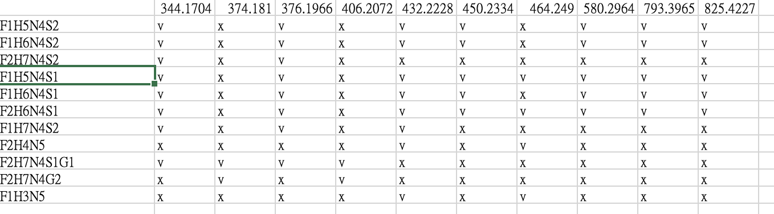

Slide 26
n=23

Slide 27
1642

Slide 30
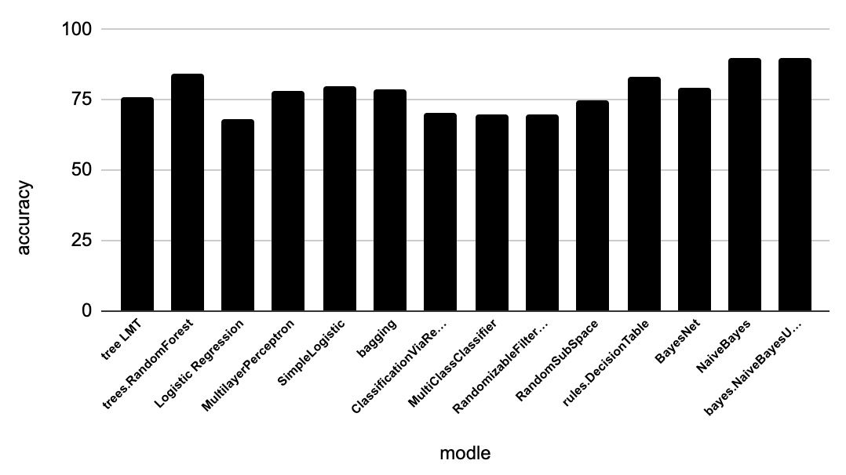
edit from WEKA_revised_zfNGbrain_20221129_1219_proc3_noques_noNa - revised_zfNGbrain_20221129_1219_proc3_noques_noNa.csv
some class only 1
Notes:
edit from WEKA_revised_zfNGbrain_20221129_1219_proc3_noques_noNa - revised_zfNGbrain_20221129_1219_proc3_noques_noNa.csv
some class only 1
many model can higher 70%
percentage split: 66
rules.DecisionTable 82.9%
tree LMT 76%
trees.RandomForest 84%
meta.AttributeSelectedClassifier 79.5455 %
meta begging 78.4091 %
meta.ClassificationViaRegression 70.4545 %
meta.IterativeClassifierOptimizer 80%
meta.LogitBoost 80%
meta.RandomCommittee 86.3636 %
meta.RandomizableFilteredClassifier 70%
meta.RandomSubSpace 75%
bayes.BayesNet 79.4574 %
bayes.NaiveBayes 89.5349 %
bayes.NaiveBayesUpdateable 89.5349 %

Slide 31
edit from WEKA_revised_zfNGbrain_20221129_1219_proc3_noques_noNa - revised_zfNGbrain_20221129_1219_proc3_noques_noNa.csv
some class only 1
many model can higher 70%
percentage split: 66
rules.DecisionTable 82.9%
tree LMT 76%
trees.RandomForest 84%
meta.AttributeSelectedClassifier 79.5455 %
meta begging 78.4091 %
meta.ClassificationViaRegression 70.4545 %
meta.IterativeClassifierOptimizer 80%
meta.LogitBoost 80%
meta.RandomCommittee 86.3636 %
meta.RandomizableFilteredClassifier 70%
meta.RandomSubSpace 75%
bayes.BayesNet 79.4574 %
bayes.NaiveBayes 89.5349 %
bayes.NaiveBayesUpdateable 89.5349 %

Slide 32
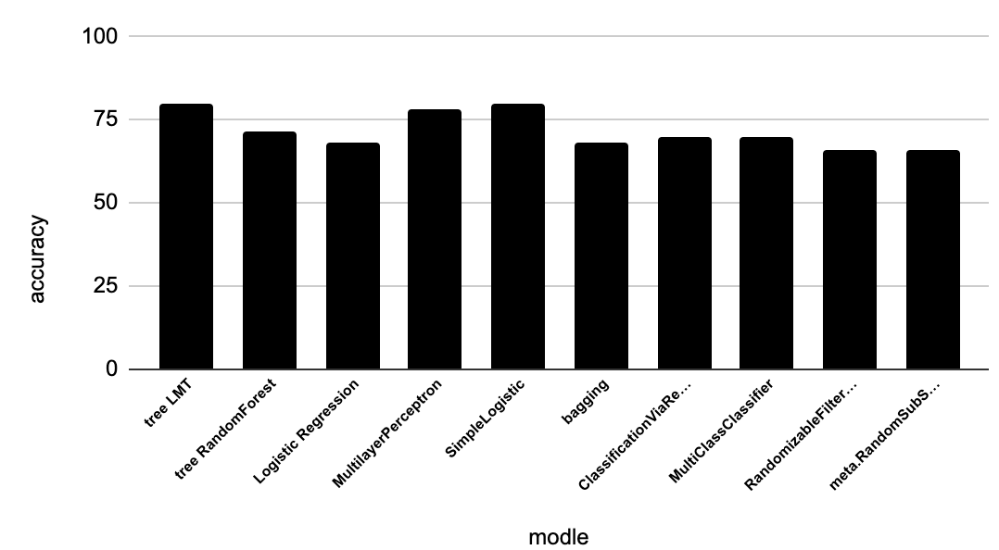
edit from WEKA_Reduced_revised_zfNGbrain_20221129_1219_proc3_noques_noNa - revised_zfNGbrain_20221129_1219_proc3_noques_noNa.csv
each class at least 10
Notes:
edit from WEKA_Reduced_revised_zfNGbrain_20221129_1219_proc3_noques_noNa - revised_zfNGbrain_20221129_1219_proc3_noques_noNa.csv
each class at least 10
percentage split: 66
tree LMT 80%
tree RandomForest 71.6667 %
function Logistic Regression with ridge parameter of 1.0E-8 68.3333 %
function MultilayerPerceptron 78.3333 %
function SimpleLogistic 80%
meta begging 68.3333 %
meta.ClassificationViaRegression 70 %
meta.MultiClassClassifier 70 %
meta.RandomizableFilteredClassifier 66%
meta.RandomSubSpace 66%

Slide 33
percentage split: 66
tree LMT 80%
tree RandomForest 71.6667 %
function Logistic Regression with ridge parameter of 1.0E-8 68.3333 %
function MultilayerPerceptron 78.3333 %
function SimpleLogistic 80%
meta begging 68.3333 %
meta.ClassificationViaRegression 70 %
meta.MultiClassClassifier 70 %
meta.RandomizableFilteredClassifier 66%
meta.RandomSubSpace 66%
Notes:
edit from WEKA_Reduced_revised_zfNGbrain_20221129_1219_proc3_noques_noNa - revised_zfNGbrain_20221129_1219_proc3_noques_noNa.csv
each class at least 10
percentage split: 66
tree LMT 80%
tree RandomForest 71.6667 %
function Logistic Regression with ridge parameter of 1.0E-8 68.3333 %
function MultilayerPerceptron 78.3333 %
function SimpleLogistic 80%
meta begging 68.3333 %
meta.ClassificationViaRegression 70 %
meta.MultiClassClassifier 70 %
meta.RandomizableFilteredClassifier 66%
meta.RandomSubSpace 66%
#-----------------------------------------------------------------------------------------------
edit from WEKA_revised_zfNGbrain_20221129_1219_proc3_noques_noNa - revised_zfNGbrain_20221129_1219_proc3_noques_noNa.csv
some class only 1
many model can higher 70%
percentage split: 66
rules.DecisionTable 82.9%
tree LMT 76%
trees.RandomForest 84%
meta.AttributeSelectedClassifier 79.5455 %
meta begging 78.4091 %
meta.ClassificationViaRegression 70.4545 %
meta.IterativeClassifierOptimizer 80%
meta.LogitBoost 80%
meta.RandomCommittee 86.3636 %
meta.RandomizableFilteredClassifier 70%
meta.RandomSubSpace 75%
bayes.BayesNet 79.4574 %
bayes.NaiveBayes 89.5349 %
bayes.NaiveBayesUpdateable 89.5349 %
#-----------------------------------------------------------------------------------------------
edit from WEKA_Reduced_revised_zfNGbrain_20221129_1219_proc3_noques_noNa - revised_zfNGbrain_20221129_1219_proc3_noques_noNa.csv
each class at least 10
rules.DecisionTable 100%
rules.OneR 100%:
in [H+]:
< 2510.7939180000003 -> F2H4N5
< 2687.8781465 -> F1H5N4S1
< 2867.4623005000003 -> F1H6N4S1
< 2954.5090055 -> F1H5N4S2
< 3056.059349 -> F2H6N4S1
< 3159.6121555 -> F1H6N4S2
< 3260.1668895000003 -> F2H7N4S1
< 3441.2440855 -> F1H7N4S2
>= 3441.2440855 -> F2H7N4S2
(176/176 instances correct)
lot of other model higher 98%

Slide 34
edit from WEKA_Reduced_revised_zfNGbrain_20221129_1219_proc3_noques_noNa - revised_zfNGbrain_20221129_1219_proc3_noques_noNa.csv
each class at least 10
Add feature “in H+”
rules.DecisionTable 100%
rules.OneR 100%:
Notes:
edit from WEKA_revised_zfNGbrain_20221129_1219_proc3_noques_noNa - revised_zfNGbrain_20221129_1219_proc3_noques_noNa.csv
some class only 1
many model can higher 70%
percentage split: 66
rules.DecisionTable 82.9%
tree LMT 76%
trees.RandomForest 84%
meta.AttributeSelectedClassifier 79.5455 %
meta begging 78.4091 %
meta.ClassificationViaRegression 70.4545 %
meta.IterativeClassifierOptimizer 80%
meta.LogitBoost 80%
meta.RandomCommittee 86.3636 %
meta.RandomizableFilteredClassifier 70%
meta.RandomSubSpace 75%
bayes.BayesNet 79.4574 %
bayes.NaiveBayes 89.5349 %
bayes.NaiveBayesUpdateable 89.5349 %

Slide 35
rules.OneR 100%:
in [H+]:
< 2510.7939180000003 -> F2H4N5
< 2687.8781465 -> F1H5N4S1
< 2867.4623005000003 -> F1H6N4S1
< 2954.5090055 -> F1H5N4S2
< 3056.059349 -> F2H6N4S1
< 3159.6121555 -> F1H6N4S2
< 3260.1668895000003 -> F2H7N4S1
< 3441.2440855 -> F1H7N4S2
>= 3441.2440855 -> F2H7N4S2
(176/176 instances correct)

Slide 36
measure
Accuracy
F1 score

Slide 37
